Slide 1

HR ANALYTICS DASHBOARD
USING POWER BI
Presented by:
Chiranjeevi Markapuram

Slide 2



Introduction to Power BI
Power BI Overview
Power BI: A powerful business analytics tool by Microsoft.
Capabilities: Visualize data, create interactive dashboards, and generate insights.
Benefits: Simplifies data analysis and sharing, empowering better decision-making across organizations.
HR Analytics: Uses data and statistical methods to gain insights into workforce trends.
Purpose: Improve decision-making in human resource management.
Dashboard Goal: Provide comprehensive insights into employee attrition patterns within the organization.
Technologies used:
POWER BI EXCEL

Slide 3
Dataset Overview
Content:
Description of the dataset: "The dataset contains 1,470 rows and 38 columns, covering detailed employee information."
Key Features:
Key Columns:
Attrition: Indicates if the employee has left the company (Yes or No).
Business Travel: Frequency of business travel.
Department: Department of the employee.
AgeGroup, Attrition Label, Attrition Count: Categorical groupings for age and attrition-related analysis.
Education Field, Job Role, Marital Status, Gender: Employee demographics.
Performance Rating, Job Satisfaction, Work-Life Balance, Environment Satisfaction: Employee feedback on their job.
Monthly Income, Total Working Years, Years At Company: Work and compensation metrics.
Numeric Variables:
Metrics like Age, Daily Rate, Monthly Rate, Distance From Home, and Training Times Last Year offer quantitative insights.
Target Variable:
Attrition: The focus of the dataset, capturing employee churn.

Slide 4
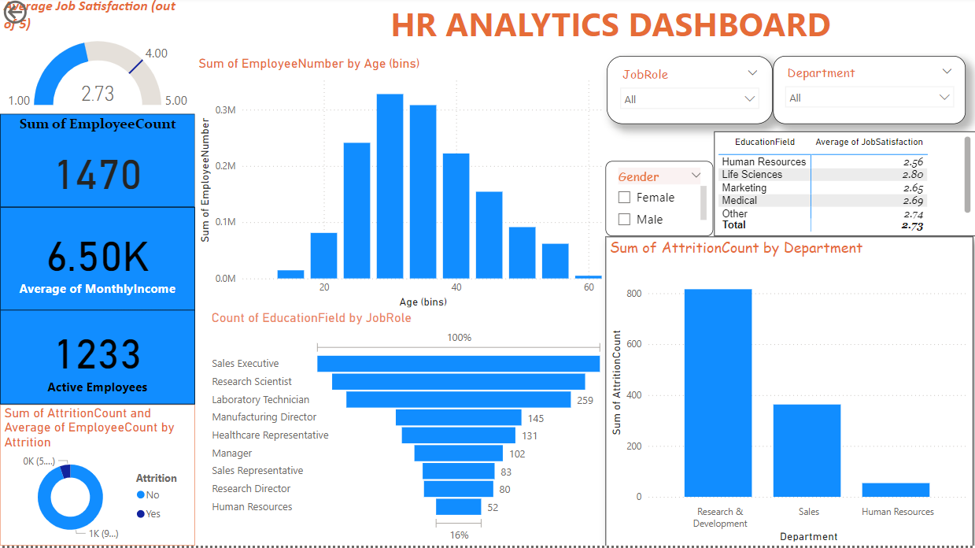
Page 1 - General Overview and Demographics

Slide 5
aa
Key Visualizations:
Job Satisfaction (Gauge): Displays an average score of 2.73, summarizing employee contentment.
Employee Count (Card): Shows the total workforce (1,470).
Monthly Income (Card): Average monthly income is ₹6.50K.
Active Employees (Card): Highlights 1,233 currently active employees.
Age Distribution (Bar Chart): Visualizes employee age demographics.
Education Field by Job Role (Bar Chart): Links educational background to job roles.
Attrition Count (Donut Chart): Shows 16.12% attrition with 237 employees leaving.
Attrition by Department (Bar Chart): Highlights departments with the highest attrition.
Job Satisfaction by Education Field (Table): Details satisfaction scores across educational fields.
s

Slide 6
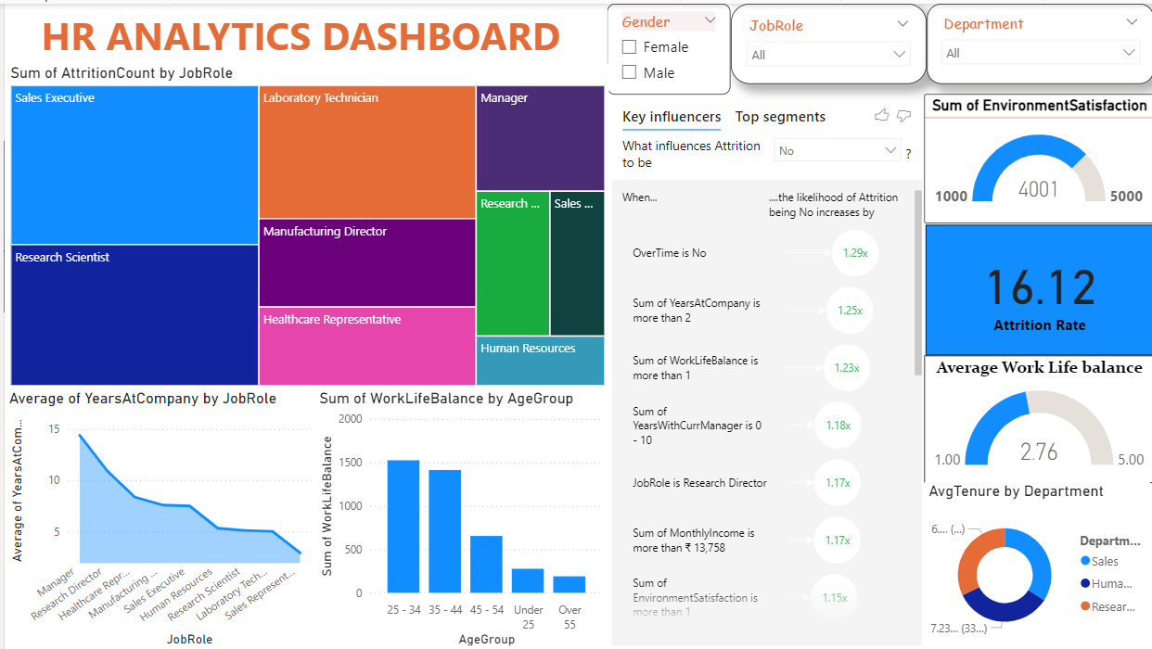
Page 2 – Overview

Slide 7
Brief Description of Key Visualizations:
Sum of AttritionCount by Job Role: A treemap showing the number of attrition events for different job roles, helping to identify which roles have higher attrition rates.
Average of YearsAtCompany by Job Role: A line chart depicting the average tenure of employees in various job roles, providing insights into employee retention by role.
Sum of WorkLifeBalance by AgeGroup: A bar chart showing the sum of work-life balance scores for different age groups, offering a view of how work-life balance varies across age demographics.
Key Influencers for Attrition: A visual displaying the factors influencing employee attrition, such as overtime status, years at the company, work-life balance, years with the current manager, job role, monthly income, and environment satisfaction, helping to understand the main drivers of attrition.
Sum of EnvironmentSatisfaction: A gauge showing the total environment satisfaction score of 4001 out of 5000, indicating the overall satisfaction with the work environment.
Attrition Rate: A metric showing the overall attrition rate of 16.12%, giving a clear view of the proportion of employees leaving the company.
Average Work-Life Balance: A gauge showing the average work-life balance score of 2.76 out of 5, reflecting how employees perceive their work-life balance.
Average Tenure by Department: A donut chart displaying the average tenure by department, highlighting the average number of years employees stay in each department.

Slide 8
Key Insights
Demographics:
Younger employees (<25 years) and single employees have higher attrition rates.
Departmental Trends:
Research & Development has the highest attrition and needs targeted retention strategies.
Human Resources exhibits lower attrition and can serve as a benchmark.
Role and Income:
Sales Representatives and Laboratory Technicians face higher attrition due to lower income levels.
Higher-paid employees, such as Managers, are more likely to stay.
Satisfaction and Travel:
Low job satisfaction ratings are strongly linked to higher turnover.
Employees with frequent travel commitments show moderate attrition levels.

Slide 9
Recommendations
Targeted Onboarding Programs: Enhance support for new hires through structured mentoring and integration plans.
Tailored Retention Strategies: Focus efforts on departments and roles with high attrition, using HR benchmarks for comparison.
Job Satisfaction Improvement: Conduct regular surveys to boost engagement, especially for roles with high dissatisfaction.
Work-Life Balance Initiatives: Mitigate travel fatigue with policies offering flexible work arrangements.
Compensation Review: Adjust salaries for lower-paid roles to align with industry standards.

Slide 10
Conclusion:
The HR Analytics Dashboard provides valuable insights into employee attrition patterns, job satisfaction, and organizational trends.
By analyzing key metrics such as demographics, job roles, and satisfaction scores, HR teams can make data-driven decisions to enhance employee retention and optimize workforce management.
The dashboard empowers HR managers to proactively address high-turnover areas and improve overall employee engagement.

Slide 11
Thanks!

